Slide 1
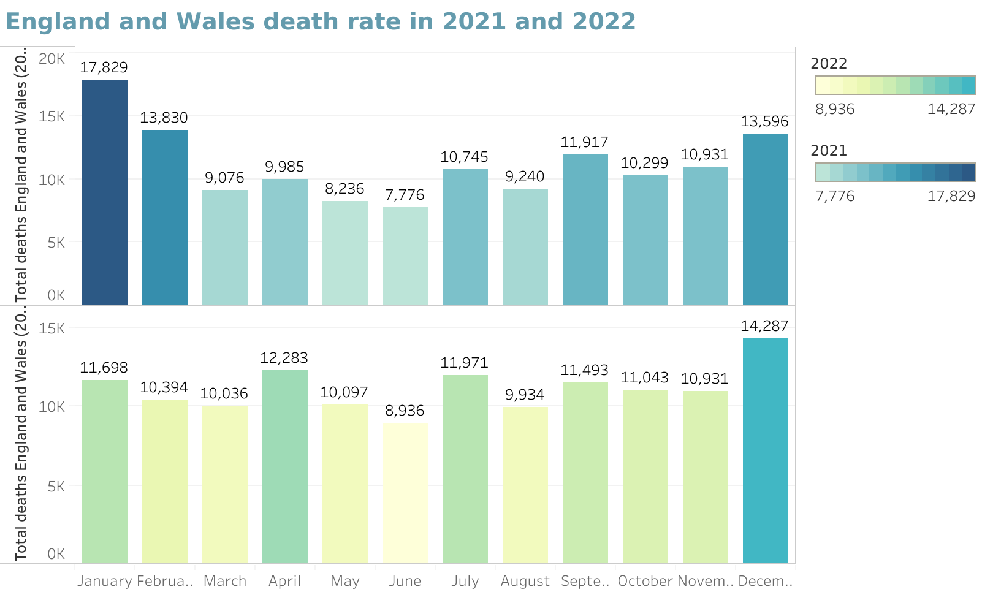
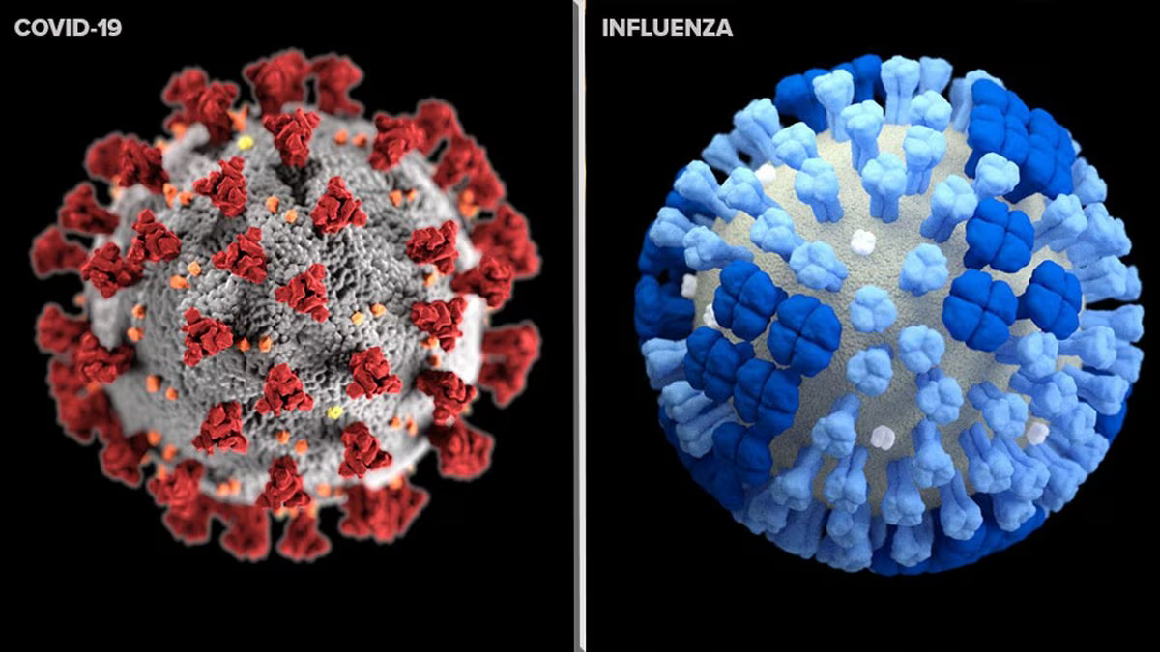
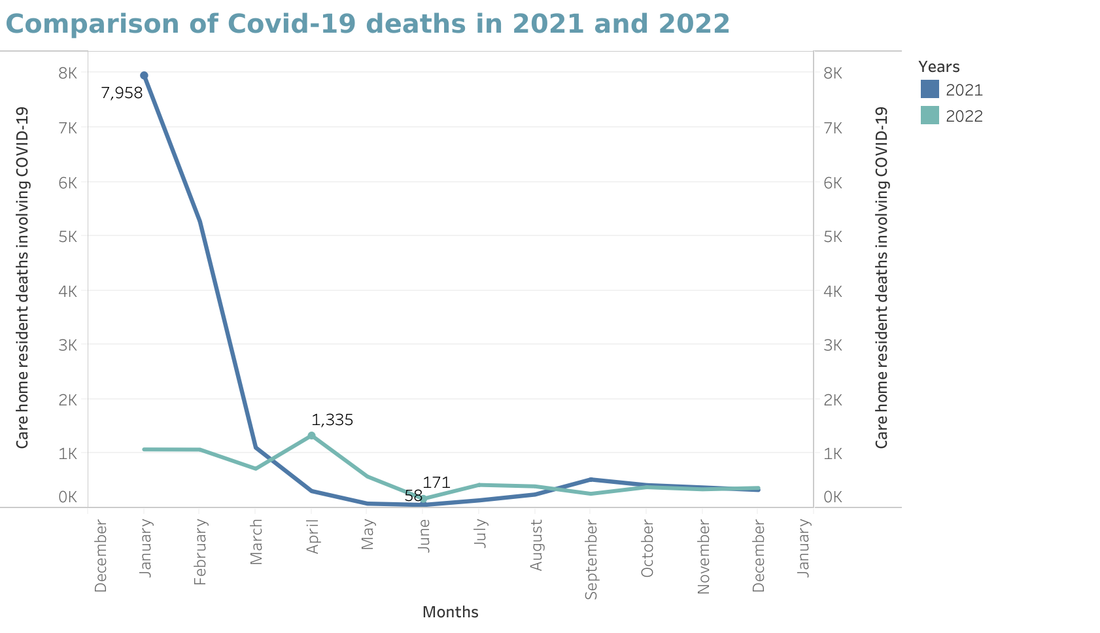
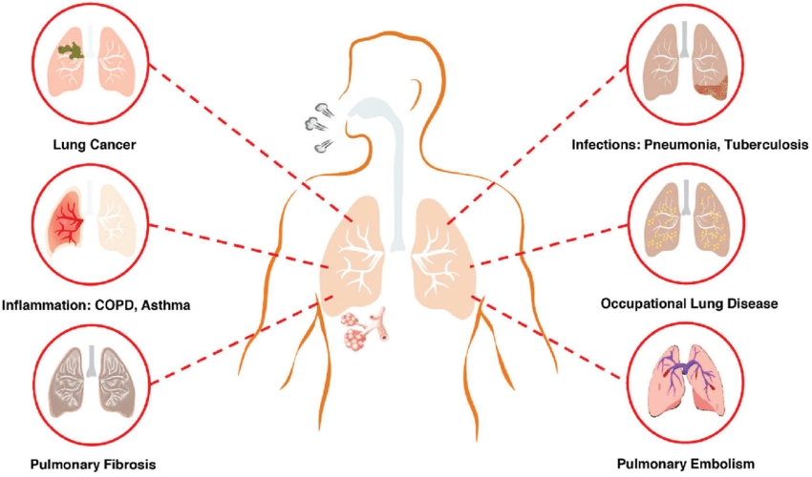
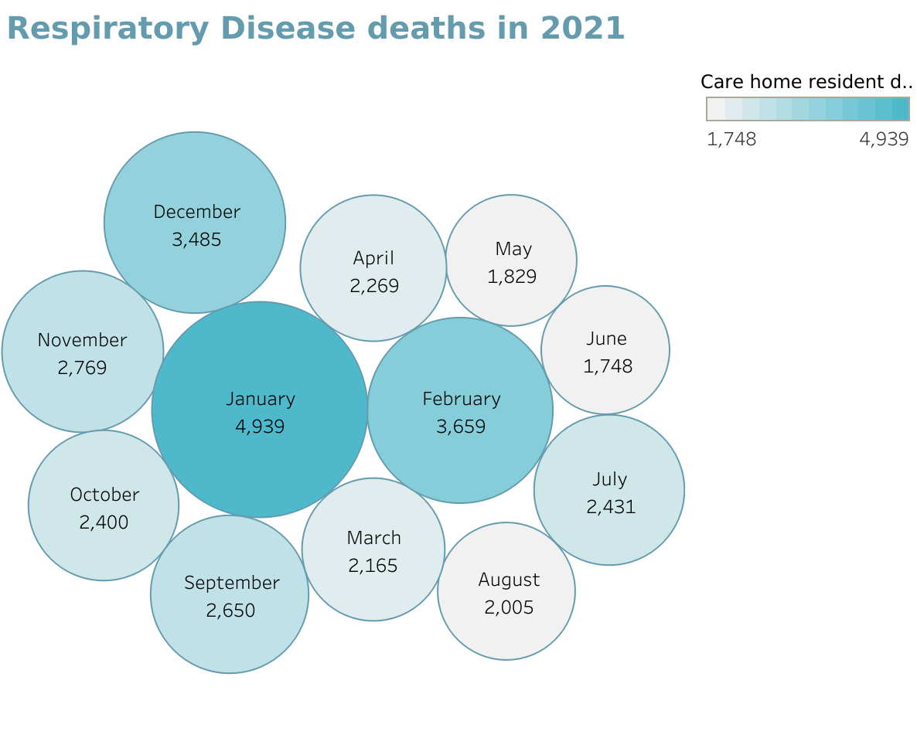
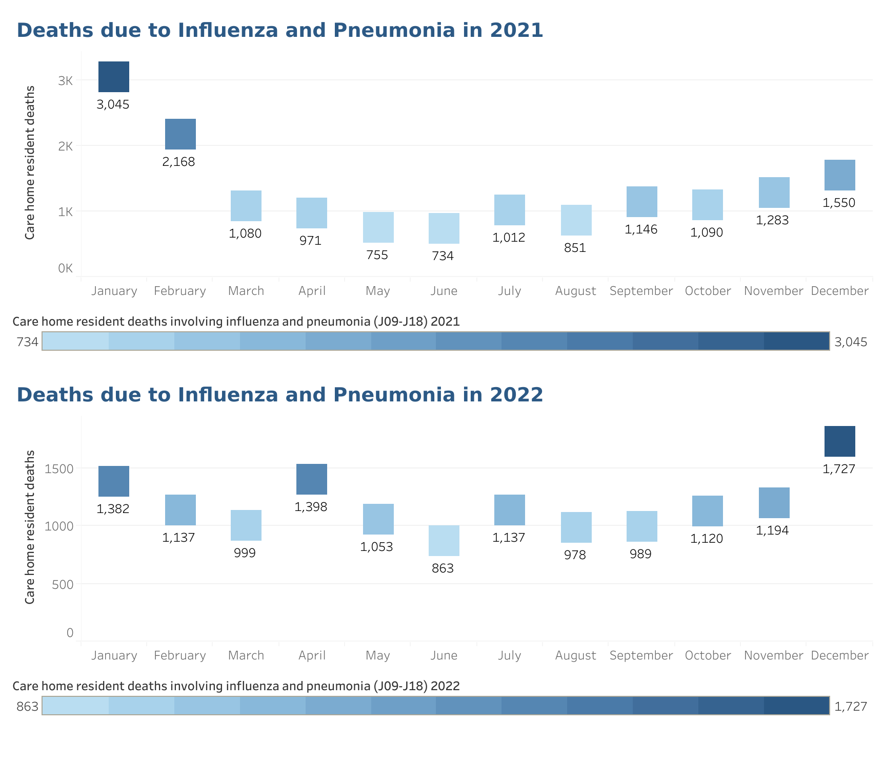
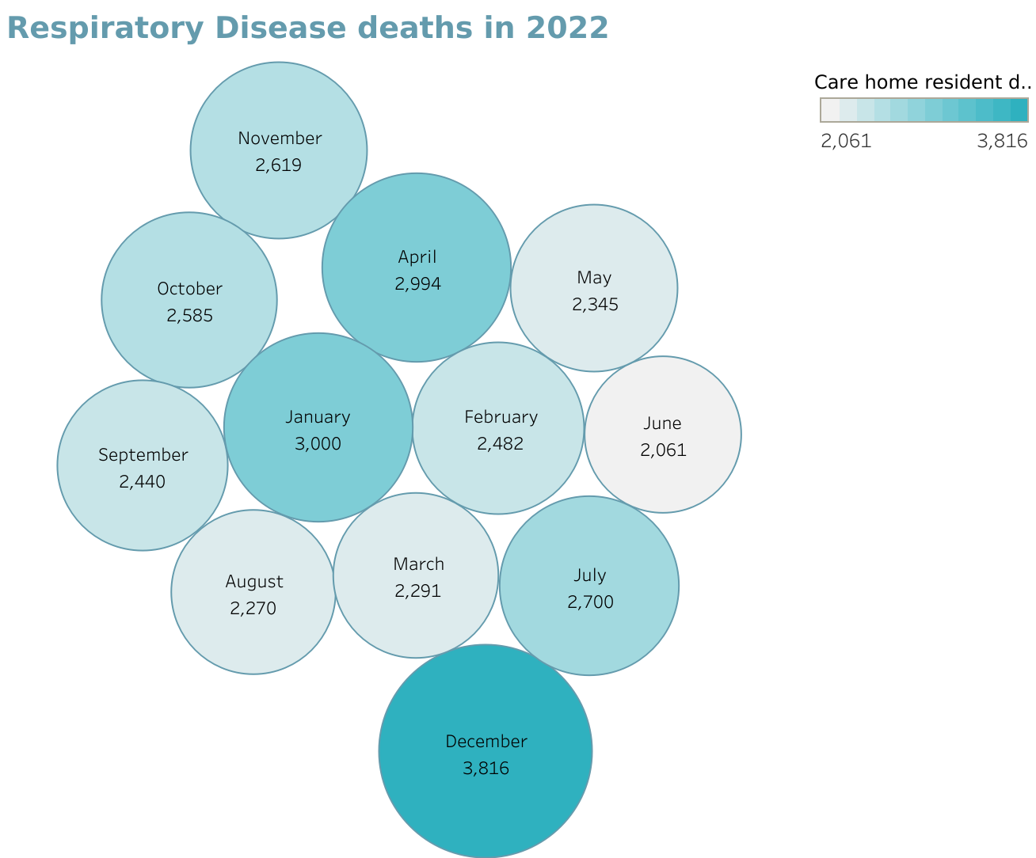
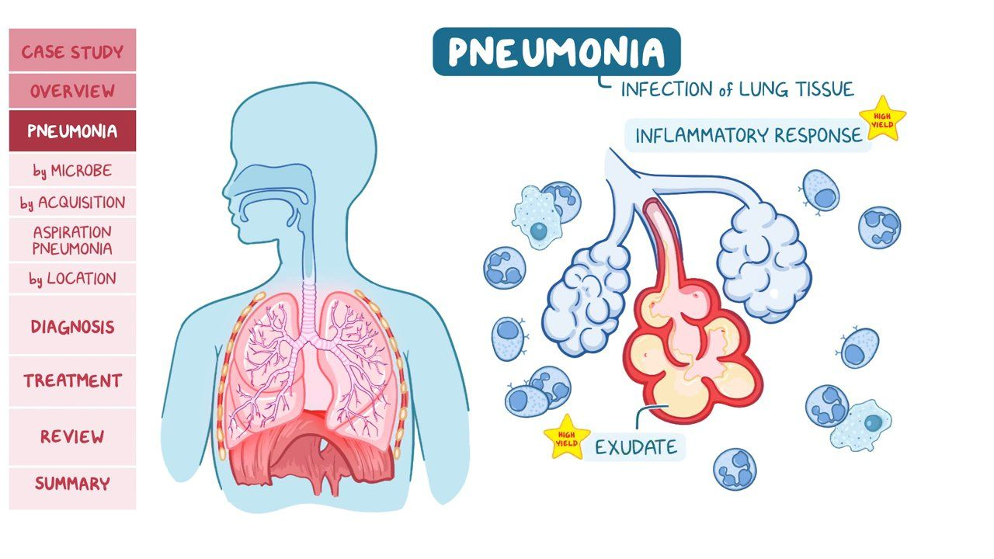
Analysis of Care Home Deaths : 2021-2022 Covid-19, Respiratory Diseases, and Influenza/Pneumonia
Identifying the causes that contribute to a higher mortality rate in care homes to provide valuable insights into public health trends and patterns. Analysis of the causes of death by analyzing the impact of Covid-19, Respiratory diseases, Influenza and Pneumonia on care home in 2021-2022, can inform the development and implementation of preventive measures by identifying factors associated with mortality rate.
Of all the deaths registered in England and Wales, 67,350 (11.5%) were due to Covid-19 in 2021. In England, there were 540,333 deaths registered in 2022, 9,016 fewer deaths than 2021. In Wales, 35,694 deaths were registered in 2022, 441 fewer deaths than 2021.
Corona virus disease which first emerged in 2019, leading to a global pandemic. Severe cases can lead to pneumonia and acute respiratory distress.
Respiratory diseases can be caused by infections such as viruses, bacteria, fungi, smoking or pollutants. Severe conditions leads to Asthma, Chronic Obstructive Pulmonary Disease and Lung Cancer.
Influenza is also a respiratory illness caused by influenza virus, which circulates seasonally, causing outbreaks and epidemics worldwide, as it spreads through respiratory droplets. It can lead to severe illness in elderly or those with weakened immune system.
Pneumonia is an infection that inflames air sacs in one or both lungs caused by various pathogens, including bacteria, viruses and fungi.
Ranging from mild to severe, it can be life-threatening to young children, the elderly and those with weakened immune system.
Reference: Data source - ONS - Office of National Statistics , Pneumonia , Respiratory Disease , Covid-19 and Influenza
Software Used : Tableau Desktop
Designed By : Neha [2254818]

